Slide 1
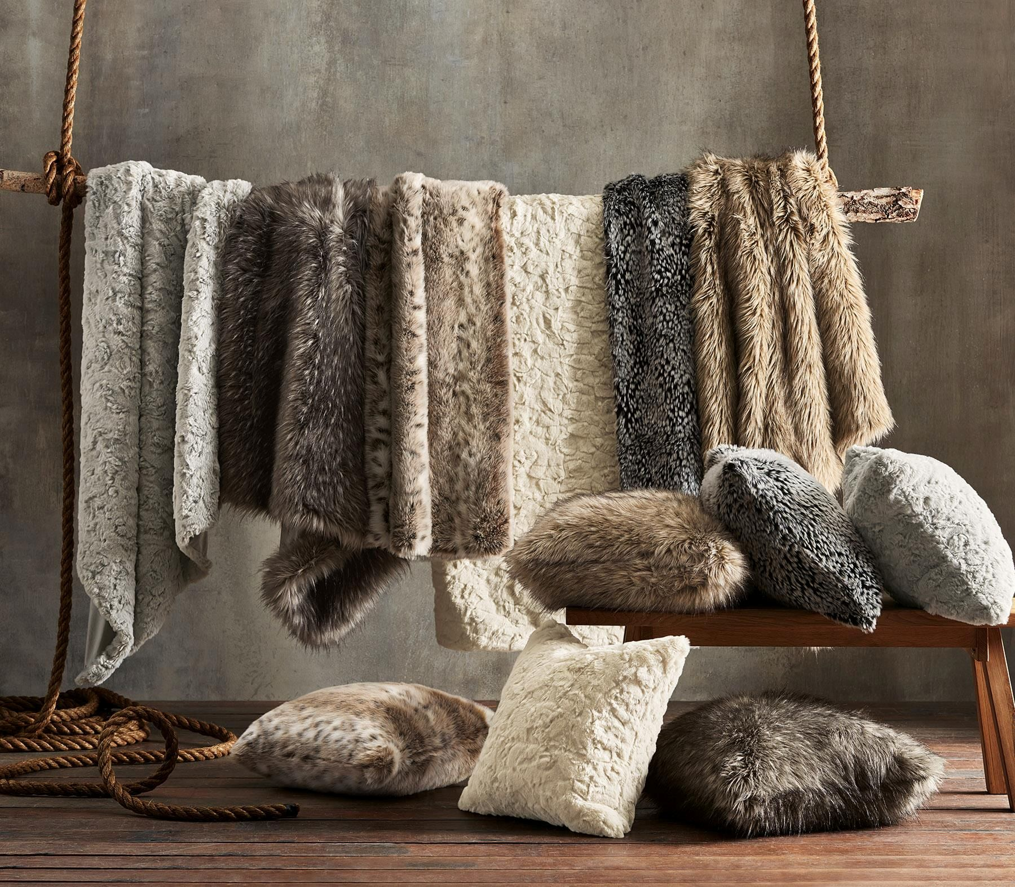
SHANGHAI GREAT WIN
HOME COLLECTION

Slide 2
SHANGHAI GREAT WIN
Established
2003
Annual Turnover
10 millions/year
Capacity
Throw: 200K pcs/month, Pillow: 50K pcs/month
Facility
2 factories for home textile, 1 factory for toy/accessory, 1 factory for garment
Address
ROOM 15A, NO.539 XINHUA ROAD, SHANGHAI, CHINA

Slide 3
Market & Buyer Detail
U.S.A :
QVC INC, HOME SHOPPING NETWORK, EVINE LIVE, CINMAR
Europe : QVC UK, etc.
Others(Canada) : The Shopping Channel, etc.

Slide 4
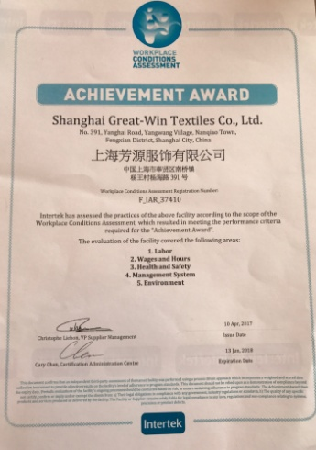
Factory Audit Certificate

Slide 5
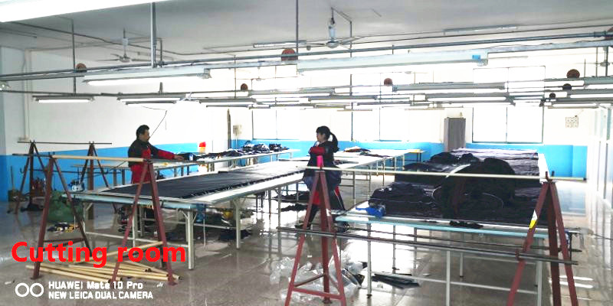
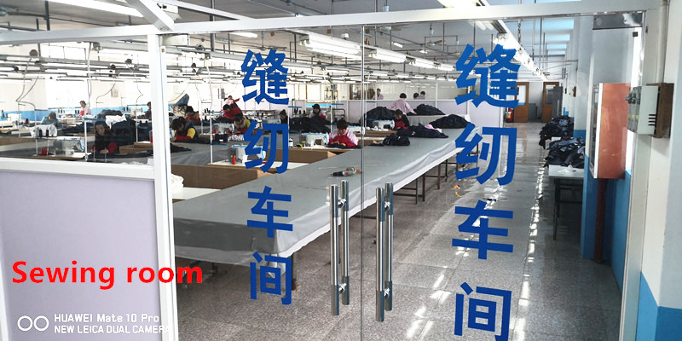
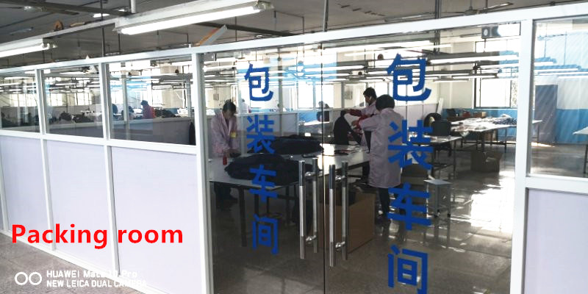
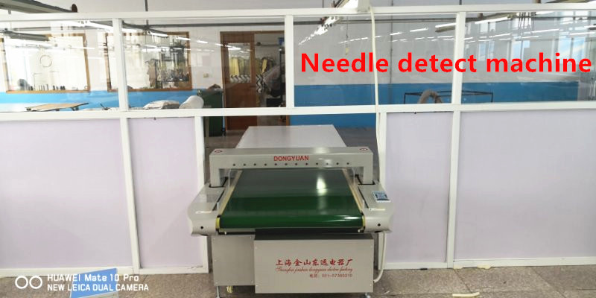
SHANGHAI GREAT WIN

Slide 6
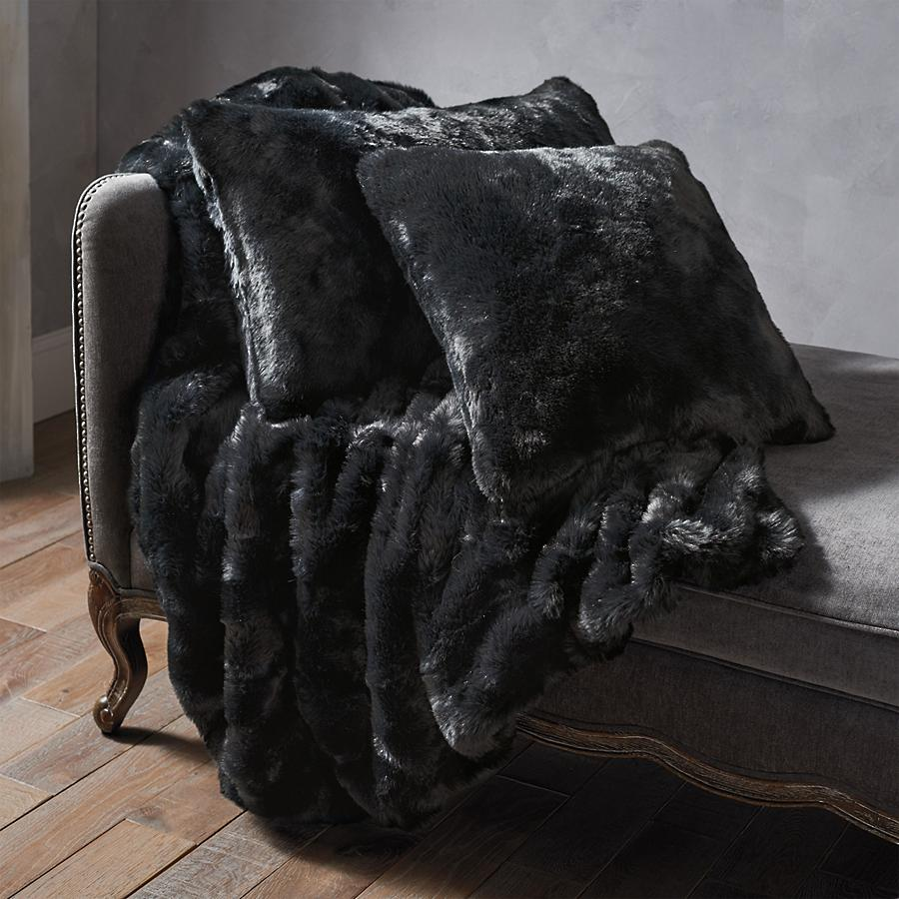
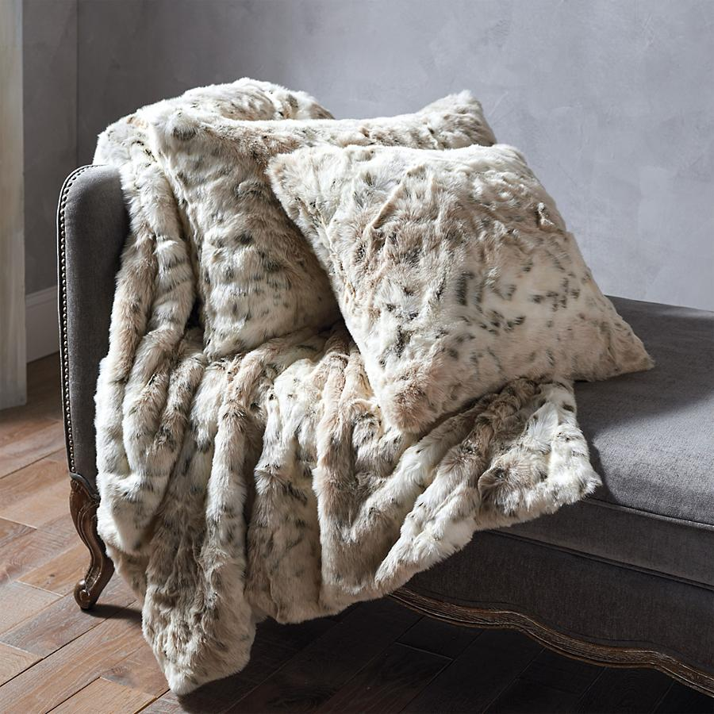
Black Fox – Solid Throw
Lynx-Print Throw

Slide 7
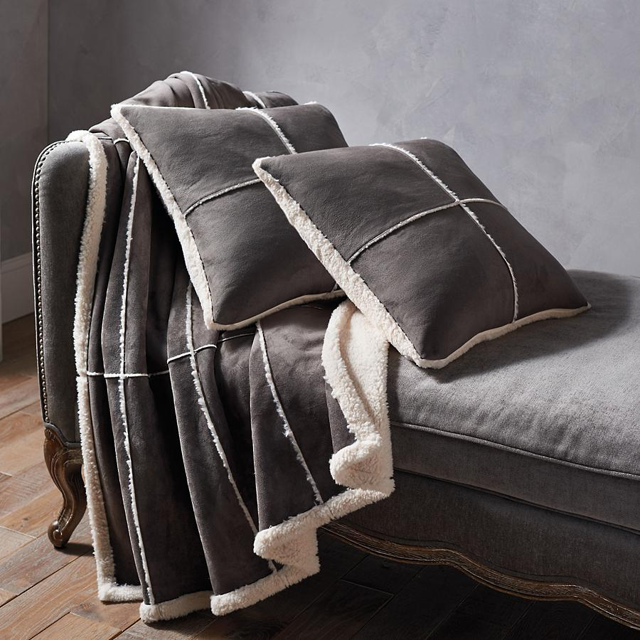
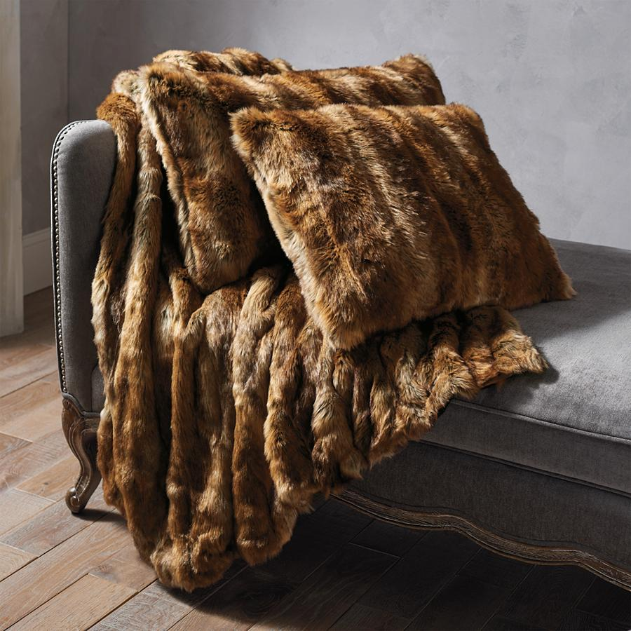
Faux Sherpa Bonded Throw
Brown Tip Print Throw

Slide 8
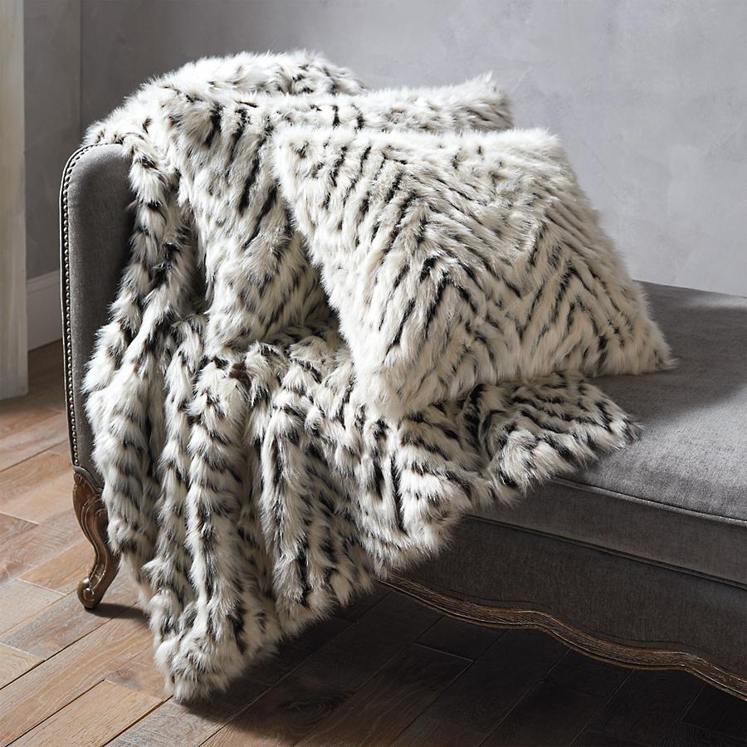
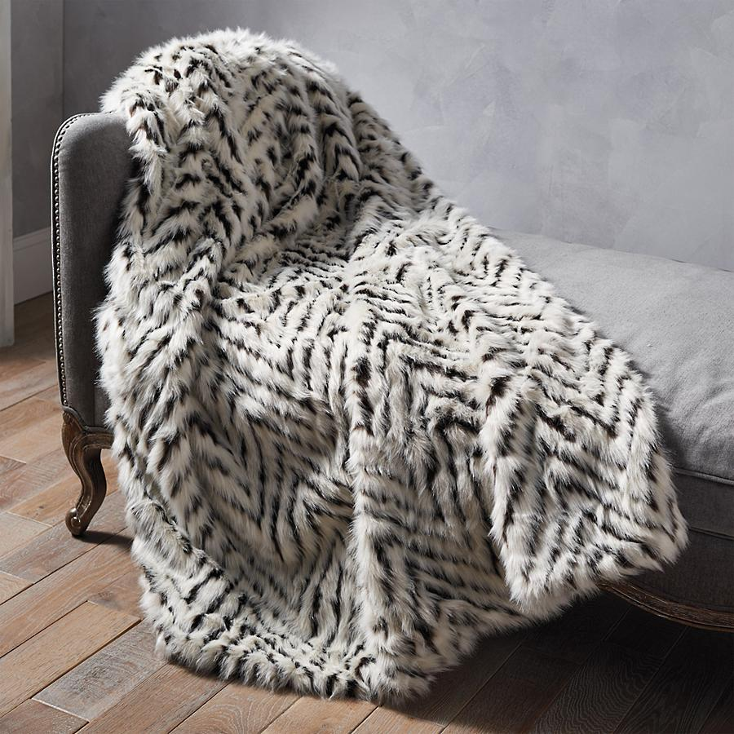
Chevron-Jacquard Pillow
Chevron-Jacquard Throw

Slide 9
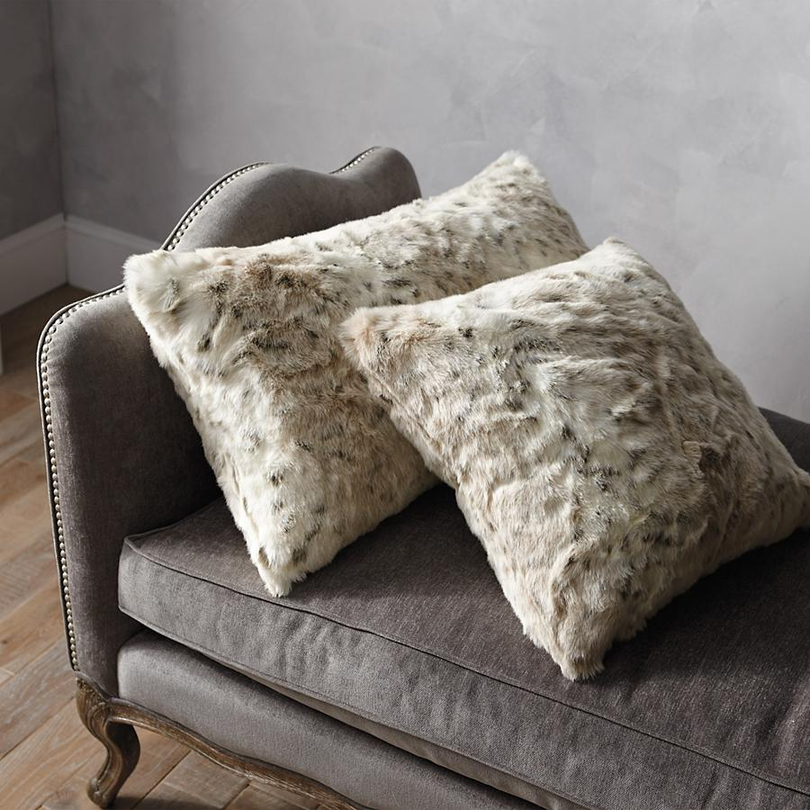
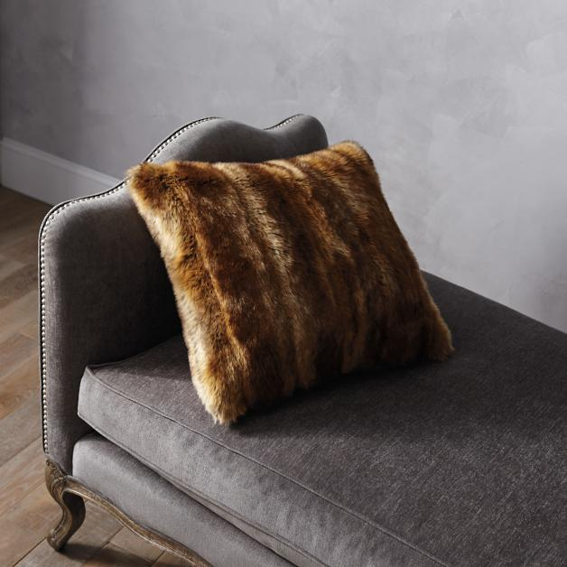
Lynx - Print Pillow
Brown Tip Print Pillow

Slide 10
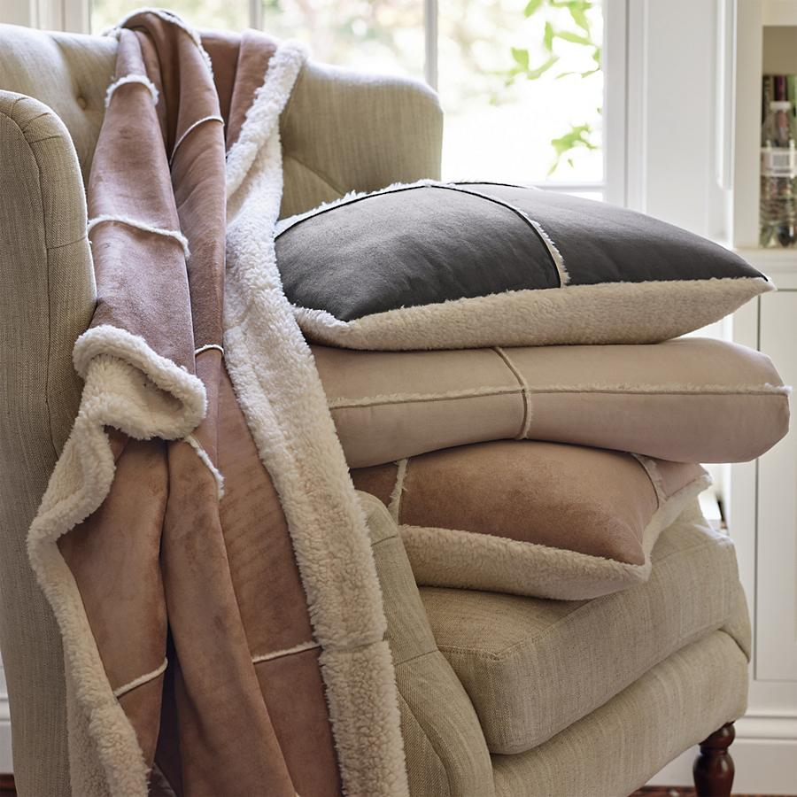
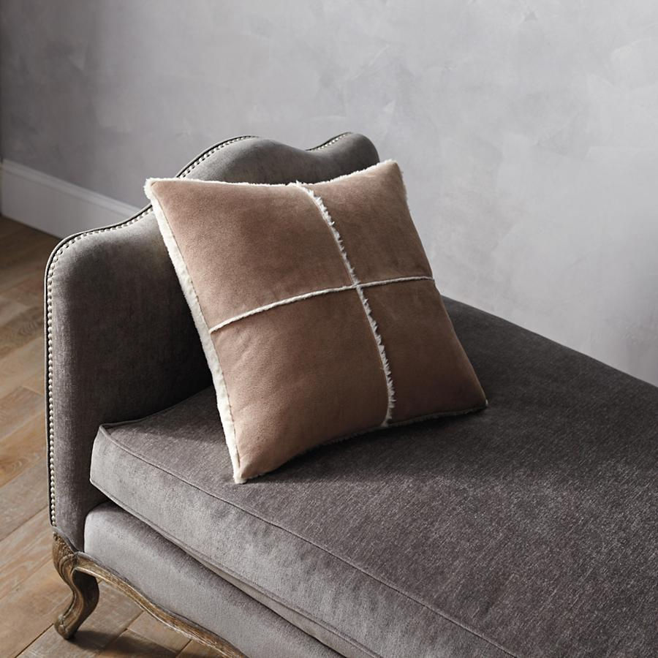
Faux Sherpa Bonded Set
Faux Sherpa Bonded Pillow

Slide 11
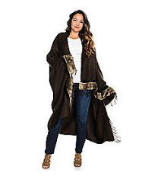
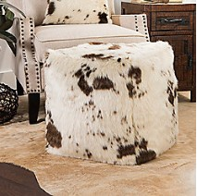
Faux Fur Wrap & Throw
Faux Fur Decorative Ottoman

Slide 12
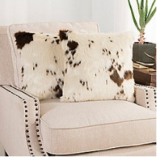
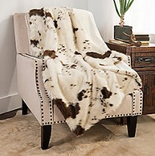
Pony Jacquard Pillow
Pony Jacquard Throw

Slide 13
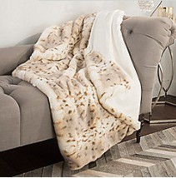
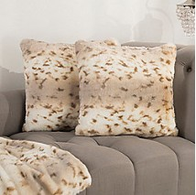
Beige Lynx Print Throw
Beige Lynx Print Pillow

Slide 14
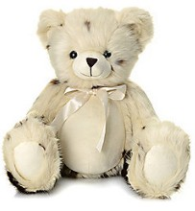
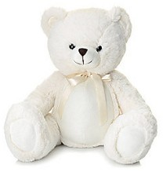
Faux Pony Teddy Bear
Faux Bunny Teddy Bear

Slide 15
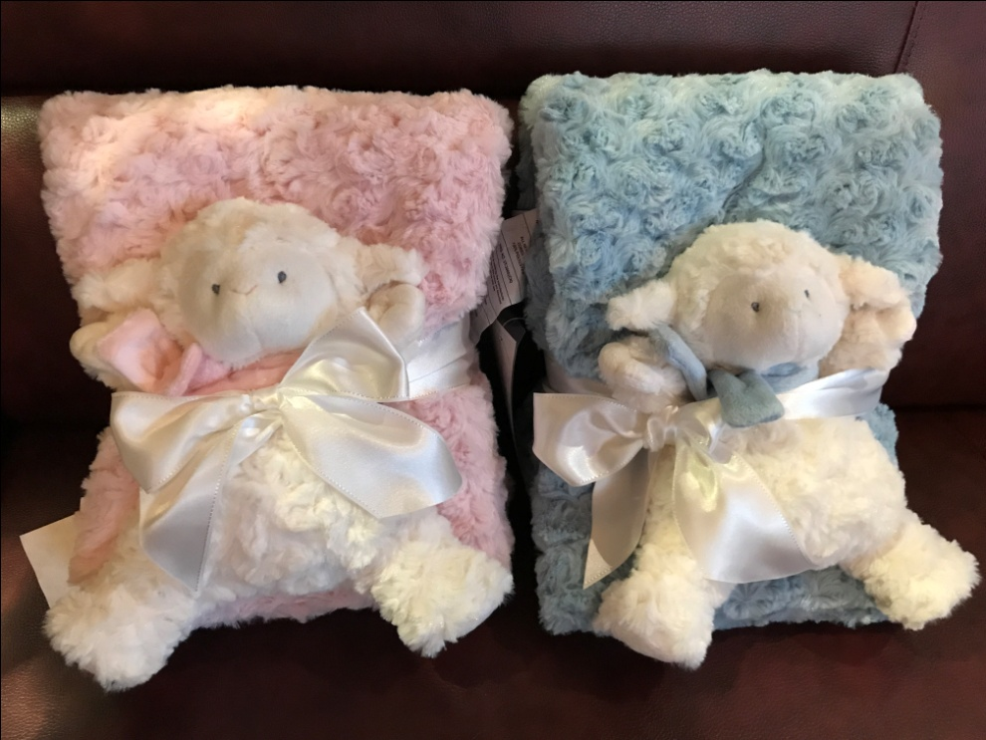
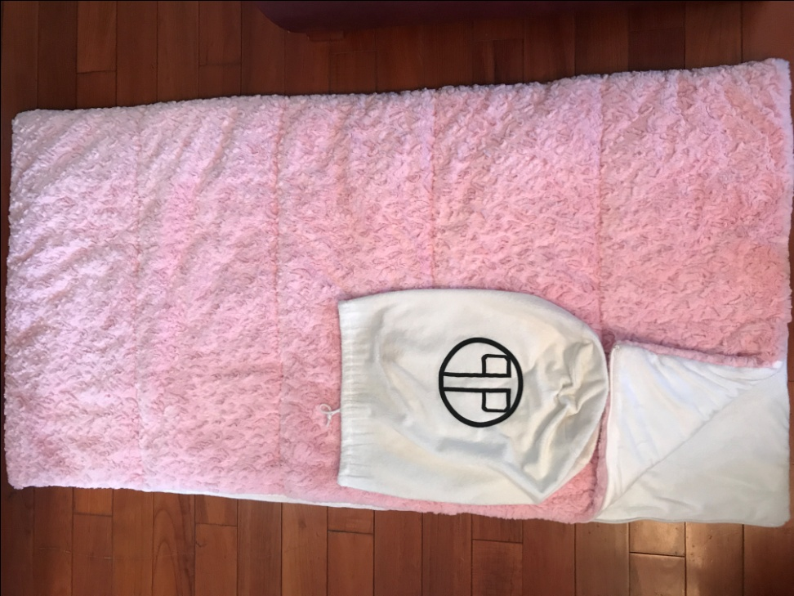
Brushed Fur Throw & Toy
Faux Fur Sleep Bag

Slide 16
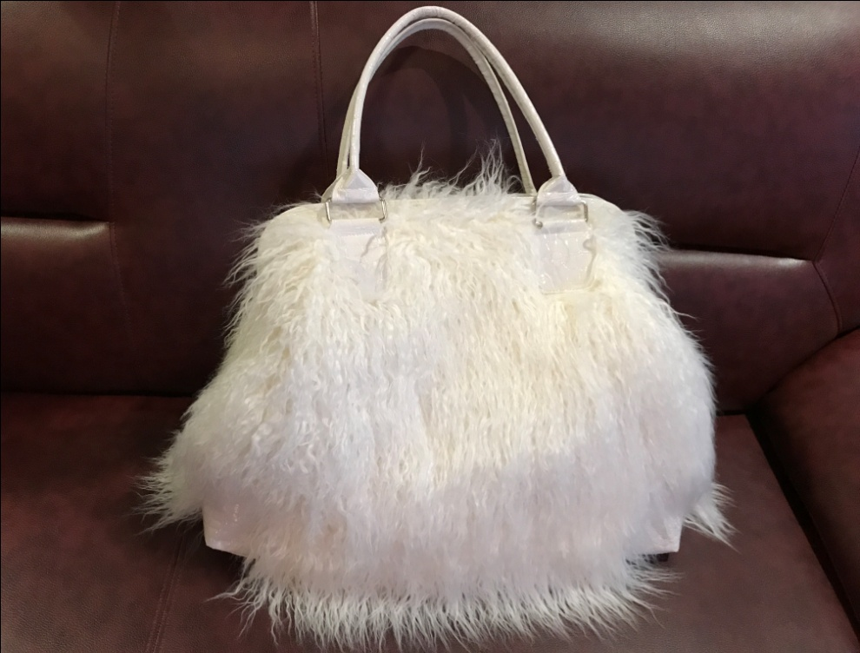
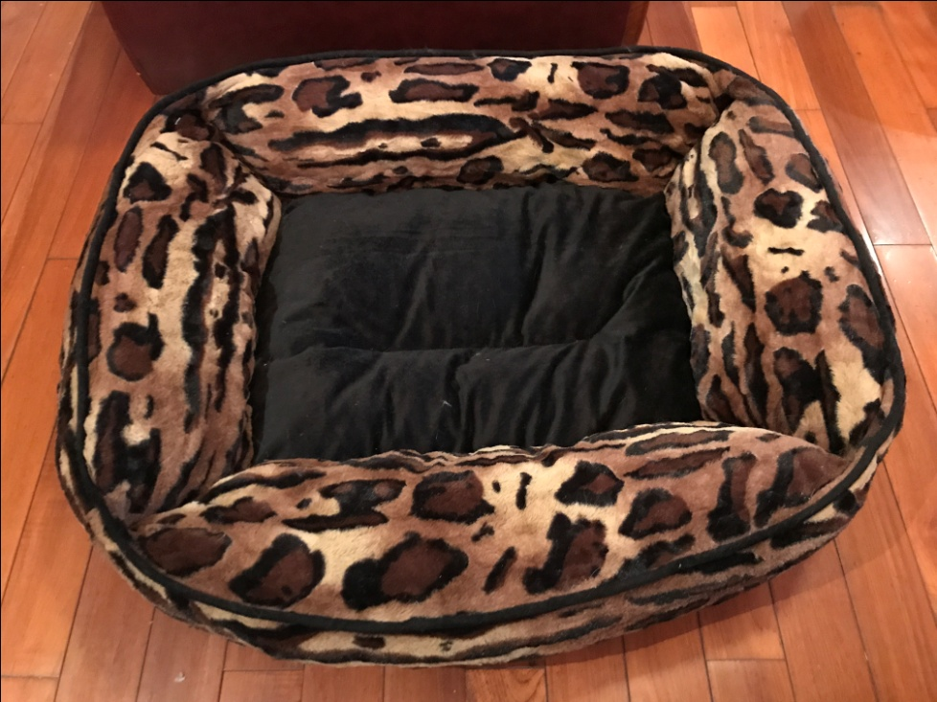
Faux Fur Handbag
Faux Fur Dog Bed

Slide 17
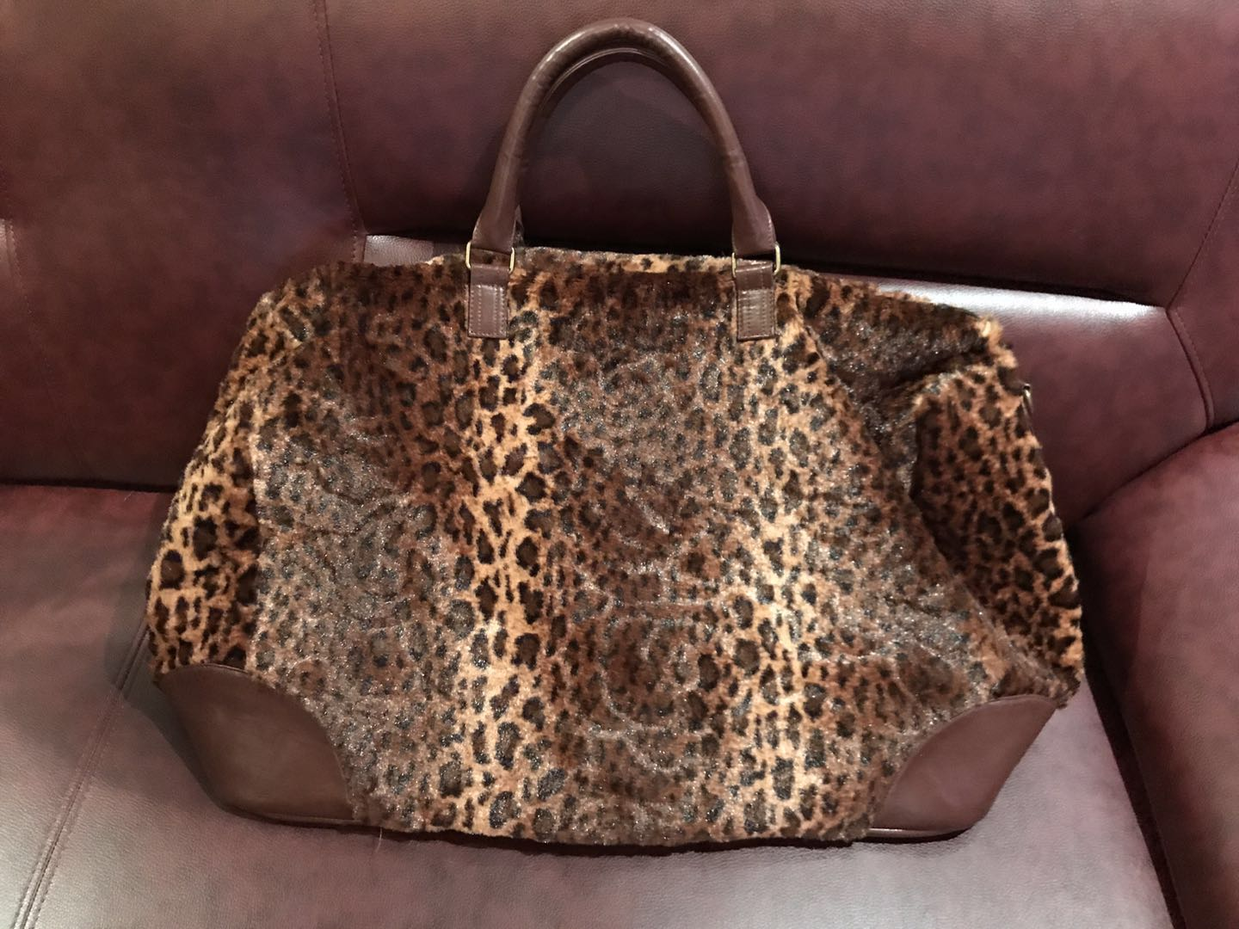
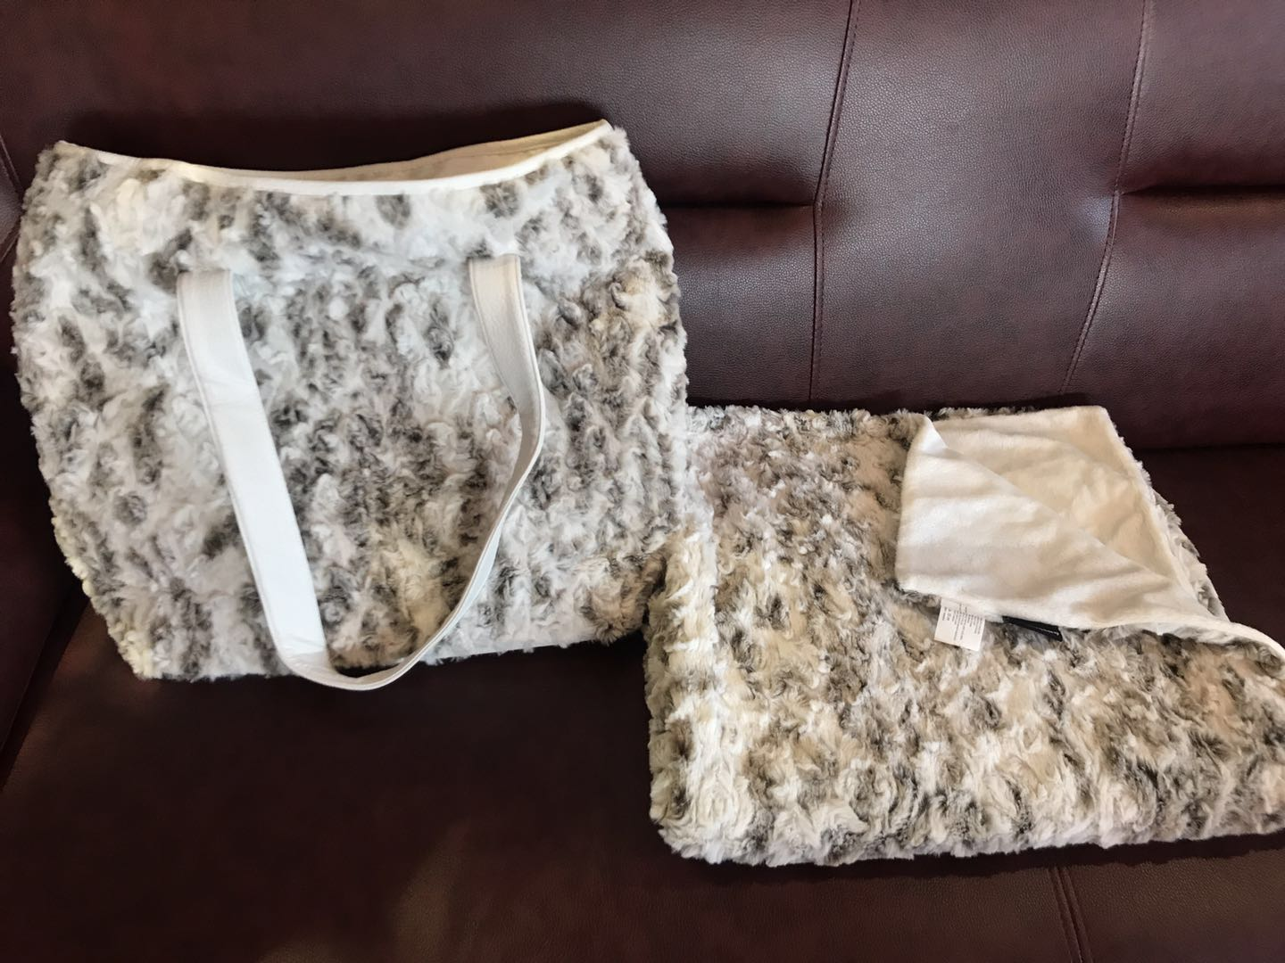
Faux Leopard Handbag
Travel Set (Bag & Throw)

Slide 18
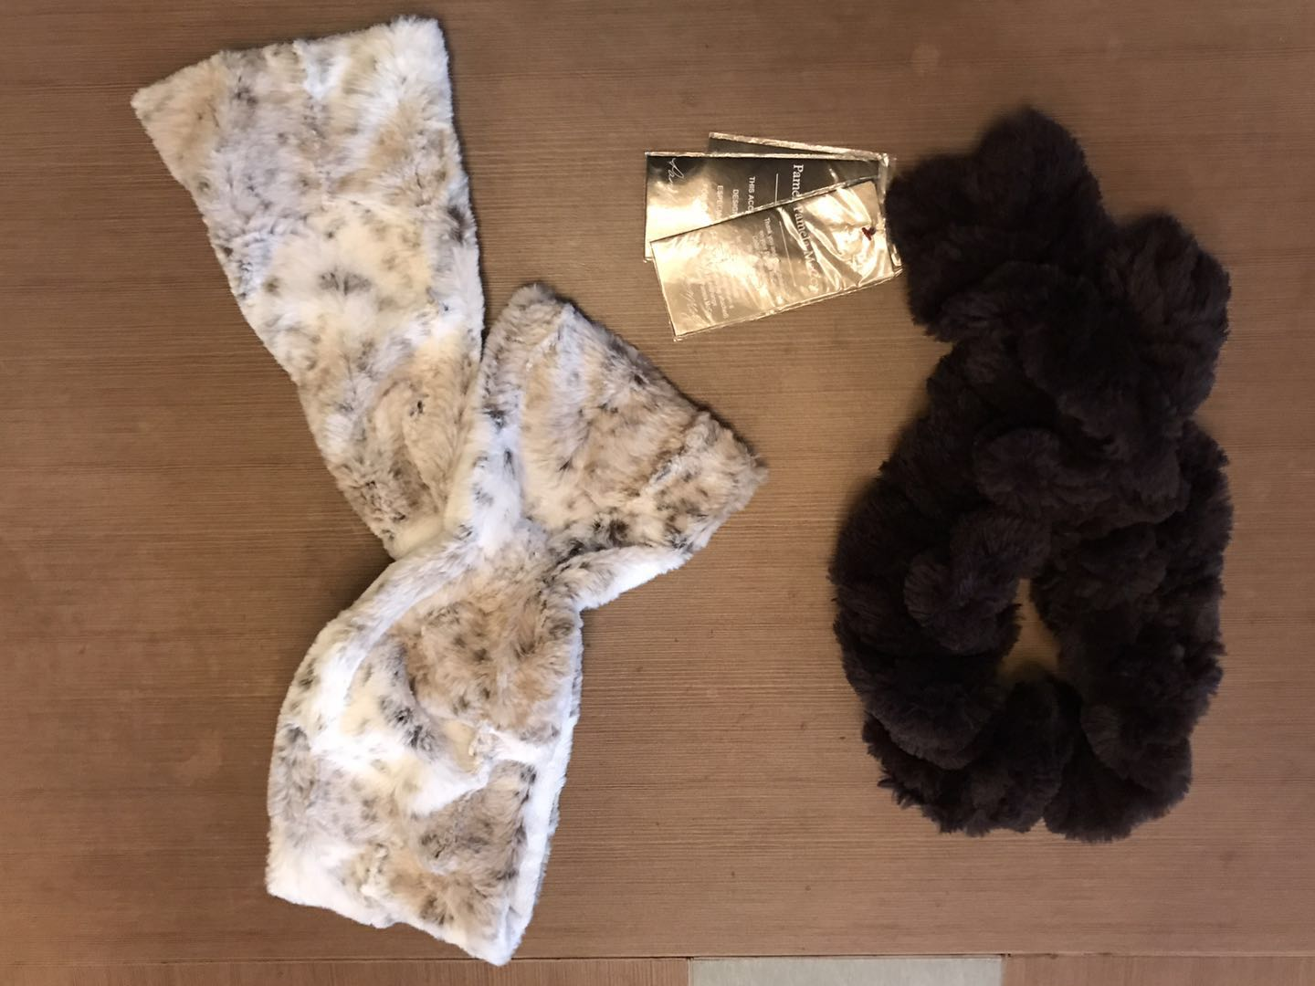
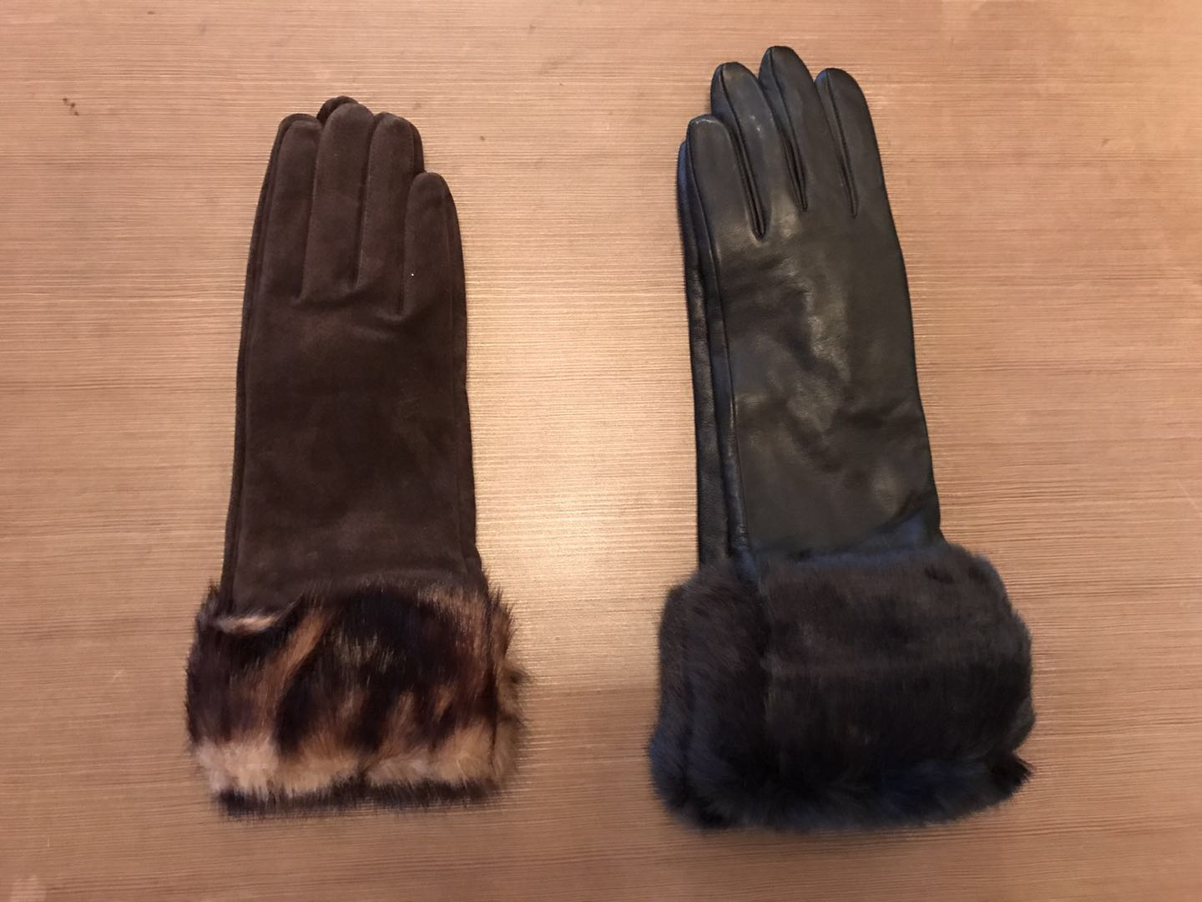
Faux Fur Scarf
Leather Glove With Fur Trim

Slide 19
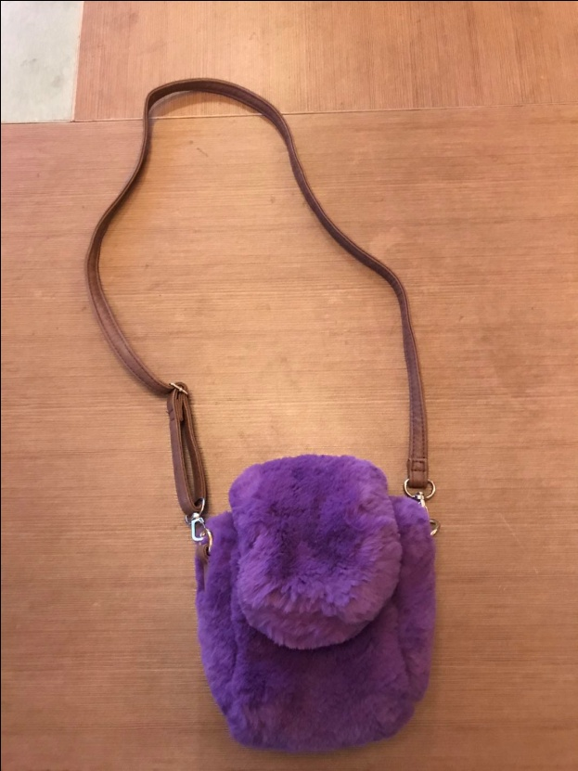
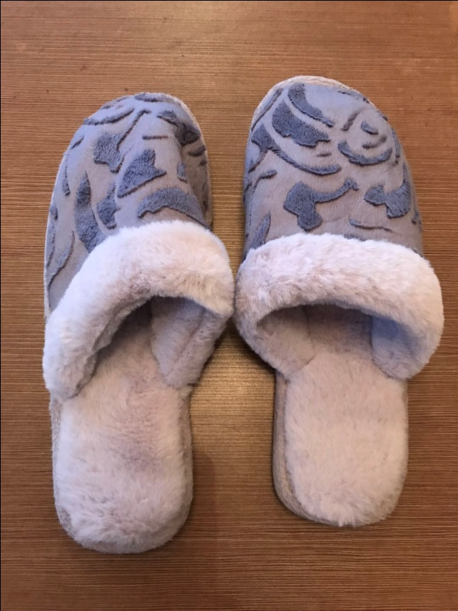
Small Faux Fur Handbag
Faux Velour Slipper

Slide 20
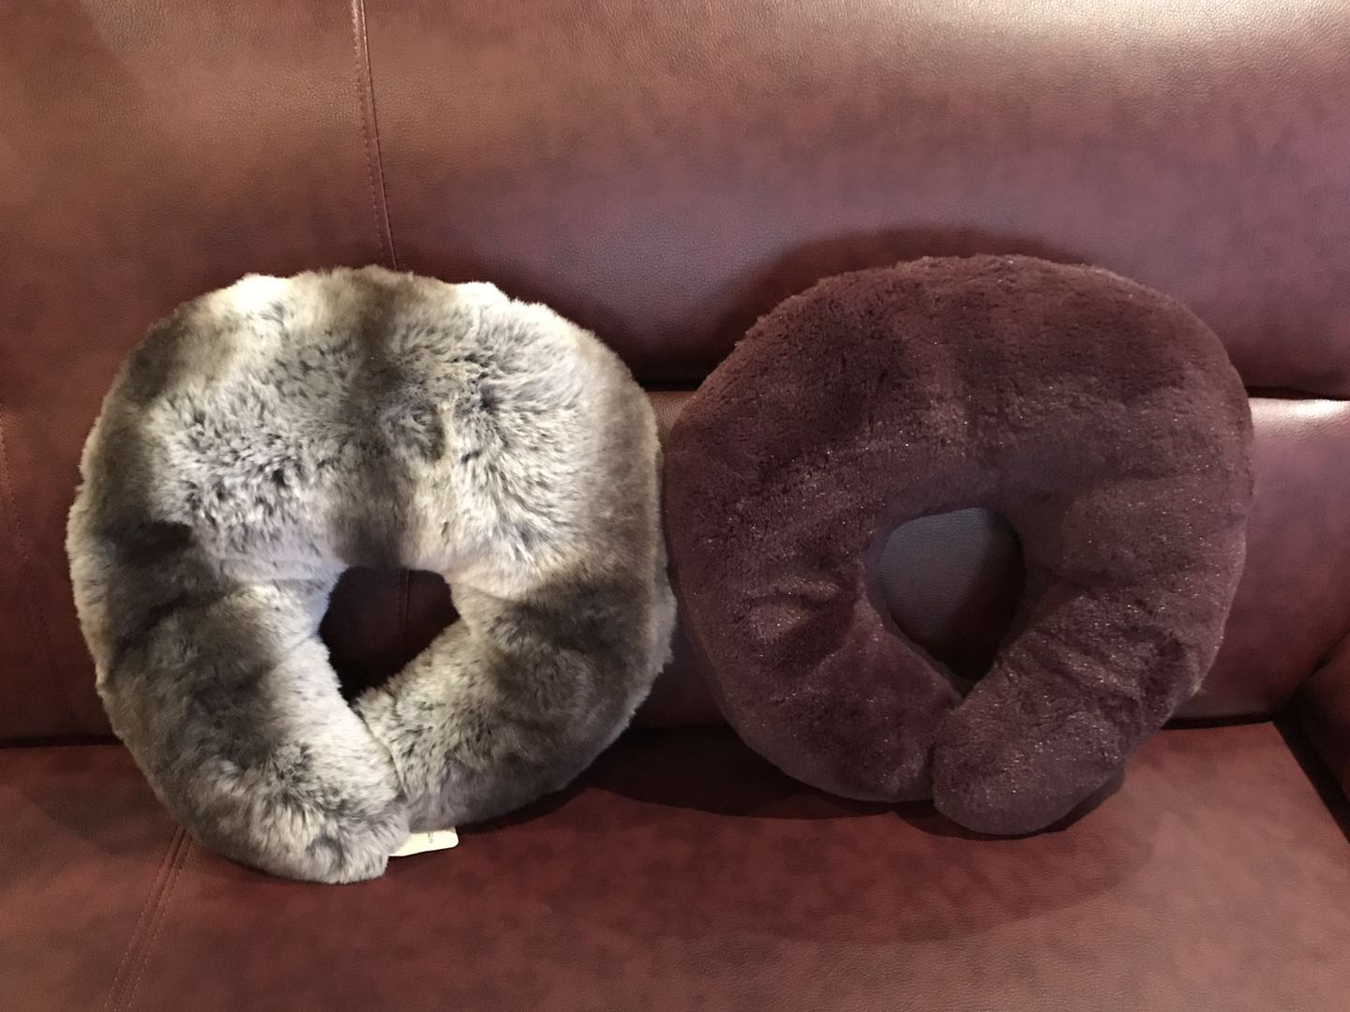
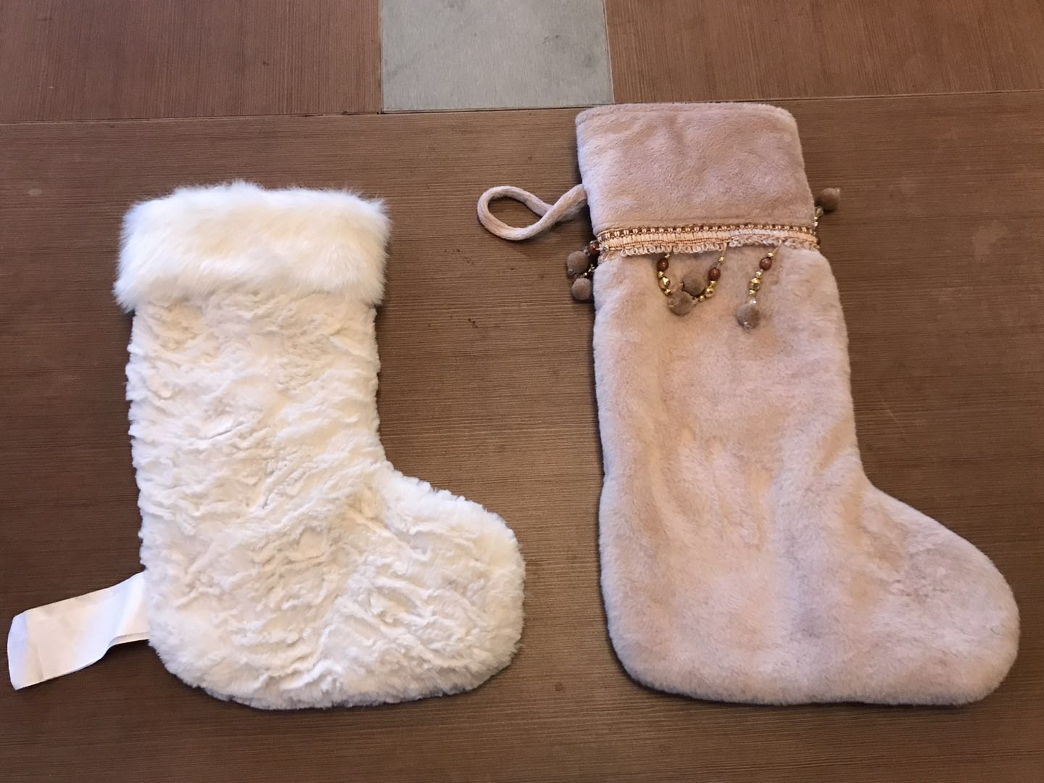
Faux Fur Head Pillow
Faux Fur Sock

Slide 21
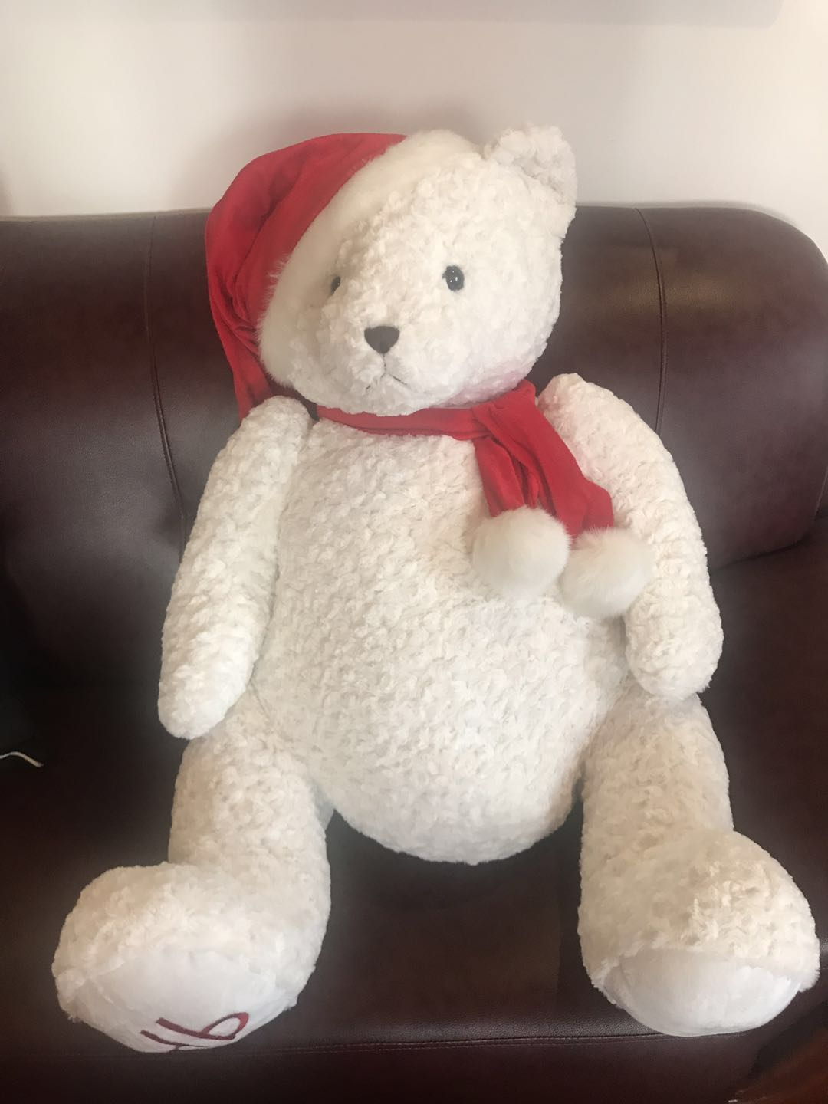
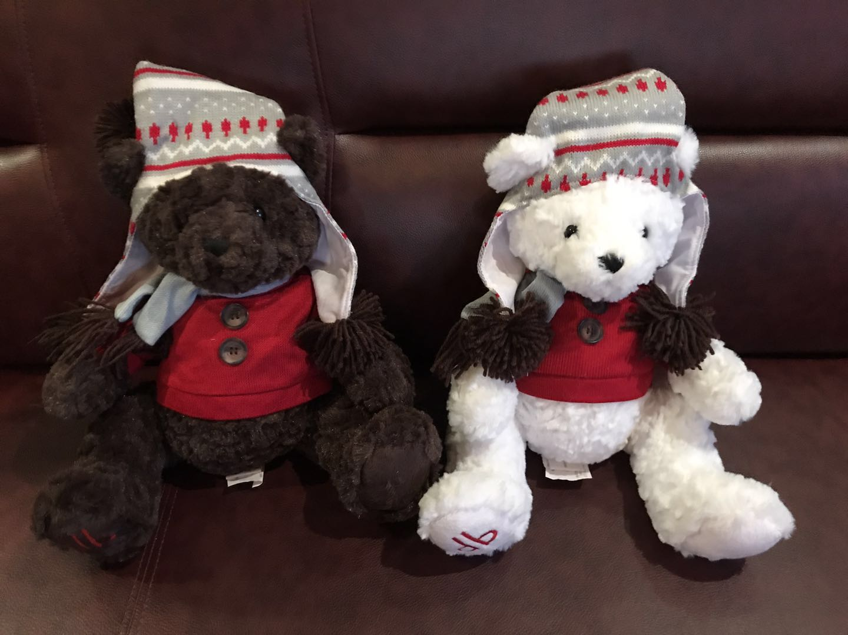
Holiday Teddy Bear
Big Santa Teddy Bear

Slide 22
The End
Thanks For Your Time
Contact person: Kevin
Shanghai Great Win Textile Co. Ltd.
Mobile: 1380-178-9133
Email: kevin@great-win.net

